Slide 1
Indian election Result
SQL Query PPT

Slide 2
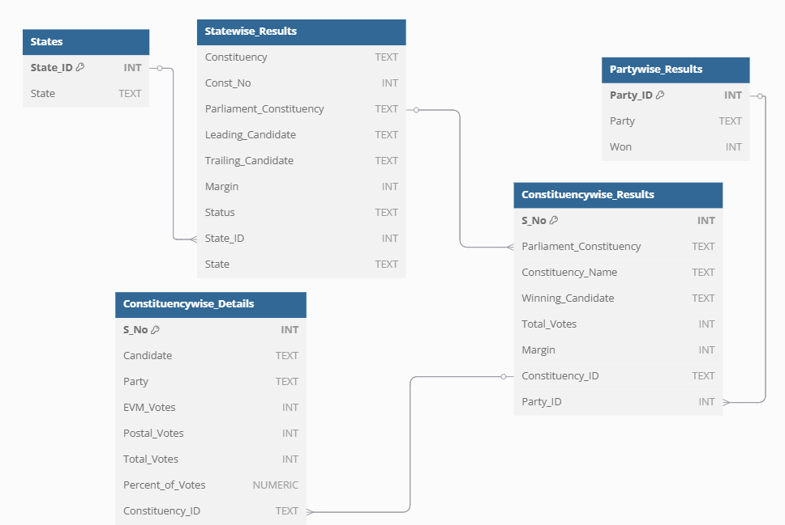

Slide 3
--1. Find the total no. of seats?
Select
Distinct Count (Parliament_Constituency) as Total_Seats
From Constituencywise_Results

Slide 4
--2. What is the total number of seats available for elections in each state
Select
States.State as State_Name,
Count(Distinct Constituencywise_Results.Constituency_Id) as Total_Seats
From Constituencywise_Results
Join Statewise_Results
On Constituencywise_Results.Parliament_Constituency = Statewise_Results.Parliament_Constituency
Join States
On Statewise_Results.State_Id = States.State_Id
Group By States.State
Order By Total_Seats Desc;

Slide 5
--3.Total Seats Won by NDA Allianz
Select
Sum(Case
When party In (
'Bharatiya Janata Party - BJP',
'Telugu Desam - TDP',
'Janata Dal (United) - JD(U)',
'Shiv Sena - SHS',
'AJSU Party - AJSUP',
'Apna Dal (Soneylal) - ADAL',
'Asom Gana Parishad - AGP',
'Hindustani Awam Morcha (Secular) - HAMS',
'Janasena Party - JnP',
'Janata Dal (Secular) - JD(S)',
'Lok Janshakti Party(Ram Vilas) - LJPRV',
'Nationalist Congress Party - NCP',
'Rashtriya Lok Dal - RLD',
'Sikkim Krantikari Morcha - SKM'
) Then (Won)
Else 0
End) As NDA_Total_Seats_Won
From
Partywise_Results

Slide 6
--4.Seats Won by NDA Allianz Parties
Select
Party as Party_Name,
Won as Seats_Won
From
Partywise_Results
Where
Party In (
'Bharatiya Janata Party - BJP',
'Telugu Desam - TDP',
'Janata Dal (United) - JD(U)',
'Shiv Sena - SHS',
'AJSU Party - AJSUP',
'Apna Dal (Soneylal) - ADAL',
'Asom Gana Parishad - AGP',
'Hindustani Awam Morcha (Secular) - HAMS',
'Janasena Party - JnP',
'Janata Dal (Secular) - JD(S)',
'Lok Janshakti Party(Ram Vilas) - LJPRV',
'Nationalist Congress Party - NCP',
'Rashtriya Lok Dal - RLD',
'Sikkim Krantikari Morcha - SKM'
)
Order By Seats_Won Desc

Slide 7
--5. Total Seats Won by I.N.D.I.A. Allianz
Select
Sum(Case
When Party In (
'Indian National Congress - INC',
'Aam Aadmi Party - AAAP',
'All India Trinamool Congress - AITC',
'Bharat Adivasi Party - BHRTADVSIP',
'Communist Party of India (Marxist) - CPI(M)',
'Communist Party of India (Marxist-Leninist) (Liberation) - CPI(ML)(L)',
'Communist Party of India - CPI',
'Dravida Munnetra Kazhagam - DMK',
'Indian Union Muslim League - IUML',
'Nat`Jammu & Kashmir National Conference - JKN',
'Jharkhand Mukti Morcha - JMM',
'Jammu & Kashmir National Conference - JKN',
'Kerala Congress - KEC',
'Marumalarchi Dravida Munnetra Kazhagam - MDMK',
'Nationalist Congress Party Sharadchandra Pawar - NCPSP',
'Rashtriya Janata Dal - RJD',
'Rashtriya Loktantrik Party - RLTP',
'Revolutionary Socialist Party - RSP',
'Samajwadi Party - SP',
'Shiv Sena (Uddhav Balasaheb Thackrey) - SHSUBT',
'Viduthalai Chiruthaigal Katchi - VCK'
) Then (Won)
Else 0
End) As INDIA_Total_Seats_Won
From
Partywise_Results

Slide 8
--6. Seats Won by I.N.D.I.A. Allianz Parties
Select
Party as Party_Name,
Won as Seats_Won
From
Partywise_Results
Where
Party In (
'Indian National Congress - INC',
'Aam Aadmi Party - AAAP',
'All India Trinamool Congress - AITC',
'Bharat Adivasi Party - BHRTADVSIP',
'Communist Party of India (Marxist) - CPI(M)',
'Communist Party of India (Marxist-Leninist) (Liberation) - CPI(ML)(L)',
'Communist Party of India - CPI',
'Dravida Munnetra Kazhagam - DMK',
'Indian Union Muslim League - IUML',
'Nat`Jammu & Kashmir National Conference - JKN',
'Jharkhand Mukti Morcha - JMM',
'Jammu & Kashmir National Conference - JKN',
'Kerala Congress - KEC',
'Marumalarchi Dravida Munnetra Kazhagam - MDMK',
'Nationalist Congress Party Sharadchandra Pawar - NCPSP',
'Rashtriya Janata Dal - RJD',
'Rashtriya Loktantrik Party - RLTP',
'Revolutionary Socialist Party - RSP',
'Samajwadi Party - SP',
'Shiv Sena (Uddhav Balasaheb Thackrey) - SHSUBT',
'Viduthalai Chiruthaigal Katchi - VCK'
)
Order By Seats_Won Desc

Slide 9
--7. Add new column field in table partywise_results to get the Party Allianz as NDA, I.N.D.I.A and OTHER
Alter Table Partywise_Results
Add Party_Alliance Varchar(50);
--I.N.D.I.A Allianz
Update Partywise_Results
Set Party_Alliance = 'I.N.D.I.A'
Where Party In (
'Indian National Congress - INC',
'Aam Aadmi Party - AAAP',
'All India Trinamool Congress - AITC',
'Bharat Adivasi Party - BHRTADVSIP',
'Communist Party of India (Marxist) - CPI(M)',
'Communist Party of India (Marxist-Leninist) (Liberation) - CPI(ML)(L)',
'Communist Party of India - CPI',
'Dravida Munnetra Kazhagam - DMK',
'Indian Union Muslim League - IUML',
'Jammu & Kashmir National Conference - JKN',
'Jharkhand Mukti Morcha - JMM',
'Kerala Congress - KEC',
'Marumalarchi Dravida Munnetra Kazhagam - MDMK',
'Nationalist Congress Party Sharadchandra Pawar - NCPSP',
'Rashtriya Janata Dal - RJD',
'Rashtriya Loktantrik Party - RLTP',
'Revolutionary Socialist Party - RSP',
'Samajwadi Party - SP',
'Shiv Sena (Uddhav Balasaheb Thackrey) - SHSUBT',
'Viduthalai Chiruthaigal Katchi - VCK'
);
--NDA Allianz
Update Partywise_Results
Set Party_Alliance = 'NDA'
Where party In (
'Bharatiya Janata Party - BJP',
'Telugu Desam - TDP',
'Janata Dal (United) - JD(U)',
'Shiv Sena - SHS',
'AJSU Party - AJSUP',
'Apna Dal (Soneylal) - ADAL',
'Asom Gana Parishad - AGP',
'Hindustani Awam Morcha (Secular) - HAMS',
'Janasena Party - JnP',
'Janata Dal (Secular) - JD(S)',
'Lok Janshakti Party(Ram Vilas) - LJPRV',
'Nationalist Congress Party - NCP',
'Rashtriya Lok Dal - RLD',
'Sikkim Krantikari Morcha - SKM'
);
--Other
Update Partywise_Results
Set Party_Alliance = 'Other'
Where Party_Alliance Is Null;

Slide 10
--8.Which party alliance (NDA, I.N.D.I.A, or OTHER) won the most seats across all states?
Select
Partywise_Results.Party_Alliance,
Count(Constituencywise_Results.Constituency_Id) As Seats_Won
From
Constituencywise_Results
Join Partywise_Results
On Constituencywise_Results.Party_Id = Partywise_Results.Party_Id
Where
Partywise_Results.Party_Alliance In ('NDA', 'I.N.D.I.A', 'Other')
Group By
Partywise_Results.Party_Alliance
Order By
Seats_Won Desc;

Slide 11
--9.What is the distribution of EVM votes versus postal votes for candidates in a specific constituency?
Select
Constituencywise_Details.Candidate,
Constituencywise_Details.Party,
Constituencywise_Details.EVM_Votes,
Constituencywise_Details.Postal_Votes,
Constituencywise_Details.Total_Votes,
Constituencywise_Results.Constituency_Name
From
Constituencywise_Details
Join Constituencywise_Results
On Constituencywise_Details.Constituency_Id = Constituencywise_Results.Constituency_Id
Where
Constituencywise_Results.Constituency_Name = 'MATHURA'
Order By Constituencywise_Details.Total_Votes Desc;

Slide 12
--10. Which candidate received the highest number of EVM votes in each constituency (Top 10)?
SELECT
cr.Constituency_Name,
cd.Constituency_ID,
cd.Candidate,
cd.EVM_Votes
FROM
constituencywise_details cd
JOIN
constituencywise_results cr ON cd.Constituency_ID = cr.Constituency_ID
WHERE
cd.EVM_Votes = (
SELECT MAX(cd1.EVM_Votes)
FROM constituencywise_details cd1
WHERE cd1.Constituency_ID = cd.Constituency_ID
)
ORDER BY
cd.EVM_Votes DESC
Limit 10;

